Slide 1

Efficient Personalized PageRank Computation: A Spanning Forests Sampling Based Approach
Meihao Liao, Rong-Hua Li, Qiangqiang Dai, Guoren Wang
Beijing Institute of Technology
mhliao@bit.edu.cn; lironghuabit@126.com; qiangd66@gmail.com; wanggrbit@126.com

Slide 2
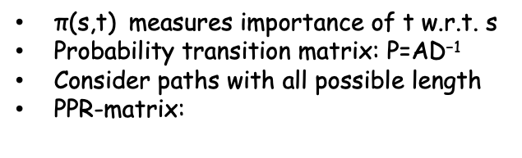
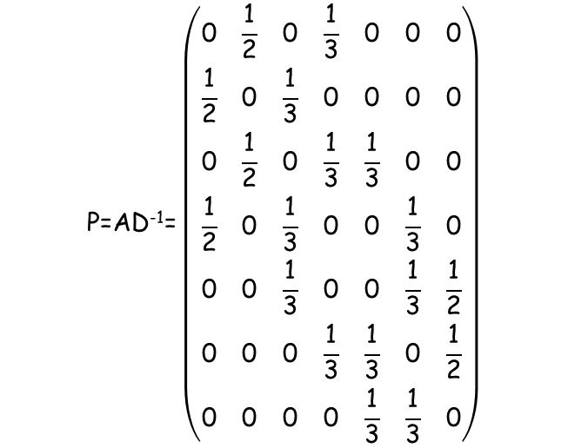


1. Problem Definition
Personalized PageRank
$$\text{P}\text{=}\text{AD}\text{−1}\text{=}\left(\begin{matrix}\text{0} & \frac{\text{1}}{\text{2}} & \text{0} & \frac{\text{1}}{\text{3}} & \text{0} & \text{0} & \text{0} \\ \frac{\text{1}}{\text{2}} & \text{0} & \frac{\text{1}}{\text{3}} & \text{0} & \text{0} & \text{0} & \text{0} \\ \text{0} & \frac{\text{1}}{\text{2}} & \text{0} & \frac{\text{1}}{\text{3}} & \frac{\text{1}}{\text{3}} & \text{0} & \text{0} \\ \frac{\text{1}}{\text{2}} & \text{0} & \frac{\text{1}}{\text{3}} & \text{0} & \text{0} & \frac{\text{1}}{\text{3}} & \text{0} \\ \text{0} & \text{0} & \frac{\text{1}}{\text{3}} & \text{0} & \text{0} & \frac{\text{1}}{\text{3}} & \frac{\text{1}}{\text{2}} \\ \text{0} & \text{0} & \text{0} & \frac{\text{1}}{\text{3}} & \frac{\text{1}}{\text{3}} & \text{0} & \frac{\text{1}}{\text{2}} \\ \text{0} & \text{0} & \text{0} & \text{0} & \frac{\text{1}}{\text{3}} & \frac{\text{1}}{\text{3}} & \text{0}\end{matrix}\right)$$
2
5
3
1
7
4
6
$\text{π}\text{(}\text{s}\text{,}\text{t}\text{)}$ measures importance of t w.r.t. s
Probability transition matrix: $\text{P}\text{=}\text{AD}\text{−1}$
Consider paths with all possible length
PPR-matrix:
$$\text{Π}\text{ppr}\text{ = }\text{α}{\text{(}\text{I}\text{−}\left(\text{1−}\text{α}\right)\text{P}\text{)}}^{\text{−1}}$$
$\text{Π}\text{ppr}\text{ = }\text{α}\text{I}\text{+}\text{α}$(1- $\text{α}$)P+ $\text{α}$(1- $\text{α}$)² P²+…
first step
second step
Personalized PageRank value $\text{π}\text{(}\text{s}\text{,}\text{t}\text{)}$ = ($\text{Π}\text{ppr}$)_{st}

Slide 3
1. Problem Definition
2
A naïve Monte Carlo method:
5
3
$\text{α}$-random walk: at every step, stops with probability $\text{α}$
1
7
6
$\text{π}\text{(}\text{s}\text{,}\text{t}\text{)}$ : Pr(an $\text{α}$-random walk starts from s stops at t)
4
If we want to know all-pair personalized pagerank…
1
4
3
Walk many steps,
2
3
Care about only the end point!
3
4
3
5
7
6
5
6
7
5
1 stops at 3
6 stops at 5
7
5

Slide 4



1. Problem Definition
When $\text{α}$ is small
When $\text{α}$ is small, the expected length of random walk will be very large.
Current algorithms are inefficient when $\text{α}$ is small !
Recently, there are applications require the cases when $\text{α}$ is small !
Local graph clustering
$$\text{π}\text{(}\text{s}\text{,}\text{u}\text{1}\text{)}\text{≥}\text{π}\text{(}\text{s}\text{,}\text{u}\text{1}\text{)}\text{≥...≥}\text{π}\text{(}\text{s}\text{,}\text{u}\text{1}\text{)}$$
$\text{Report}$ the set S_{k}=(u₁,…,u_{k}) with the lowest conductance
s
$$\text{c}\text{(}\text{S}\text{)=}\frac{\text{E}\text{(}\text{S}\text{,}\text{V}\text{−}\text{S}\text{)}}{\text{min}\text{(}\text{vol}\left(\text{S}\right)\text{,}\text{vol}\text{(}\text{V}\text{−}\text{S}\text{))}}$$
Graph Embedding / Graph Neural Network
Using $\text{Π}\text{ppr}$ to propagate features
When $\text{α}$ is small, a larger part of graph will be explored!

Slide 5
1. Problem Definition
2
A naïve Monte Carlo method:
5
3
$\text{α}$-random walk: at every step, stops with probability $\text{α}$
1
7
6
$\text{π}\text{(}\text{s}\text{,}\text{t}\text{)}$ : Pr(an $\text{α}$-random walk starts from s stops at t)
4
1
4
3
2
3
2
If we want to know all-pair personalized pagerank…
5
3
3
4
3
1
7
5
7
6
5
4
6
6
7
5
1
4
3
Walk many steps,
7
5
2
3
Care about only the end point!
3
2
Again,
1 is rooted in 3
6 is rooted in 5
5
4
3
1
3
7
5
7
6
5
4
6
6
7
5
1 stops at 3
6 stops at 5
Rooted Spanning Forest as a summary!
7
5

Slide 6
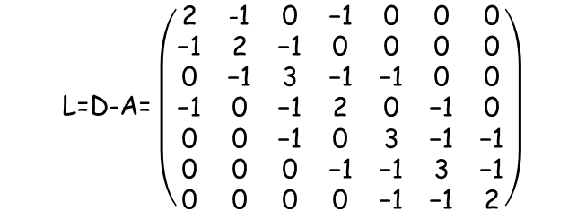
2. Our Solutions
Matrix-tree Theorem
$$\text{L}\text{=}\text{D}\text{−}\text{A}\text{=}\left(\begin{matrix}\text{2} & \text{−1} & \text{0} & \text{−1} & \text{0} & \text{0} & \text{0} \\ \text{−1} & \text{2} & \text{−1} & \text{0} & \text{0} & \text{0} & \text{0} \\ \text{0} & \text{−1} & \text{3} & \text{−1} & \text{−1} & \text{0} & \text{0} \\ \text{−1} & \text{0} & \text{−1} & \text{2} & \text{0} & \text{−1} & \text{0} \\ \text{0} & \text{0} & \text{−1} & \text{0} & \text{3} & \text{−1} & \text{−1} \\ \text{0} & \text{0} & \text{0} & \text{−1} & \text{−1} & \text{3} & \text{−1} \\ \text{0} & \text{0} & \text{0} & \text{0} & \text{−1} & \text{−1} & \text{2}\end{matrix}\right)$$
2
5
3
1
7
4
6
A well-known result lies at the heart of Graph Theory
$$\text{det}\text{(}\text{Lv}\text{) = \# }\text{of} \text{spanning} \text{trees}$$
Proof: Expand the determinant

Slide 7


2. Our Solutions
From spanning tree to spanning forest…
2
5
3
1
7
4
6
Define a probability distribution over all random spanning forests:
Pr(F₁) $\text{∝}$ ${\text{(}\frac{\text{α}}{\text{1−}\text{α}}\text{)}}^{\text{2}}$
Pr(F₂) $\text{∝}$ ${\text{(}\frac{\text{α}}{\text{1−}\text{α}}\text{)}}^{\text{4}}$
Pr(F) $\text{∝}$ ($\text{α}$/1- $\text{α}$)^(# roots of F)
We prove that: $\text{π}\text{(}\text{s}\text{,}\text{t}\text{)}$ = Pr(s rooted in t in a RSF sampled from this distribution)

Slide 8



2. Our Solutions
Personalized Pagerank Matrix Forest Theorem
$$\text{Π}\text{ppr}\text{ = }\text{α}{\text{(}\text{I}\text{−}\left(\text{1−}\text{α}\right)\text{P}\text{)}}^{\text{−1}} \text{= }{\text{L}}_{\text{β}}^{\text{−1}}$$
${{\text{L}}_{\text{β}}\text{=(}\text{β}\text{D}\text{)}}^{\text{−1}}\text{(}\text{L}\text{+}\text{β}\text{D}\text{)}$, $\text{β}$=$\frac{\text{α}}{\text{1−}\text{α}}$
$\text{β}$-Laplacian

Slide 9
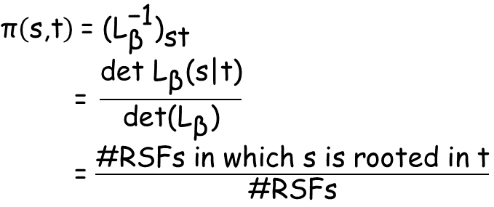
2. Our Solutions
Personalized Pagerank Matrix Forest Theorem
$$\text{π}\left(\text{s}\text{,}\text{t}\right) \text{= }{{\text{(}\text{L}}_{\text{β}}^{\text{−1}}\text{)}}_{\text{st}}$$
$$\text{ = }\frac{\text{det} {\text{L}}_{\text{β}}\text{(}\text{s}\text{|}\text{t}\text{)}}{\text{det}\text{(}{\text{L}}_{\text{β}}\text{)}}$$
= $\frac{\text{\#}\text{RSFs} \text{in} \text{which} \text{s} \text{is} \text{rooted} \text{in} \text{t}}{\text{\#}\text{RSFs}}$
t
s
Cramer’s rule
A generalization result of the well-known matrix tree theorem
Similar proof strategies with matrix-tree theorem
Cauchy-Binet formula
Leibniz expansion formula

Slide 10
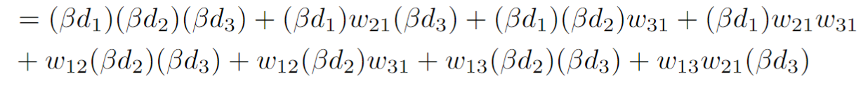








2. Our Solutions
For Example, Given a simple graph G:
V1
V1
V1
V1
V3
V3
V3
V3
V1
V2
V2
V2
V2
V3
1
$$\frac{w_{12}}{βd_{2}}$$
$$\frac{w_{31}}{βd_{3}}$$
$$\frac{w_{21}w_{31}}{(βd_{2})(βd_{3})}$$
V2
V1
V1
V1
V1
G has 8 rooted spanning forests:
V3
V3
V3
V3
V2
V2
V2
V2
$$\frac{w_{12}w_{31}}{(βd_{1})(βd_{3})}$$
$$\frac{w_{12}}{βd_{1}}$$
$$\frac{w_{31}}{βd_{1}}$$
$$\frac{w_{13}w_{21}}{(βd_{1})(βd_{2})}$$
$$\text{det}\text{(}{\text{L}}_{\text{β}}\text{+}\text{β}\text{D}\text{)}$$
We have:

Slide 11
2. Our Solutions
More than this…
2
2
5
5
1
3
1
3
7
7
4
6
4
6
local
global
partition
From local to global, there are additional information:
Not only s rooted in t, but also s, t, v1, v2, … are in the same partition
Fact: Given a fixed partition, the probability which node is root is (weighted) uniform
For example, in the left partition:
When we get a sample,
We identically get 4 samples.
Pr(1 is root)=1/4
Pr(4 is root)=1/4
Pr(2 is root)=1/4
This leads to variance reduction(Rao-Blackwellization)
Pr(3 is root)=1/4

Slide 12
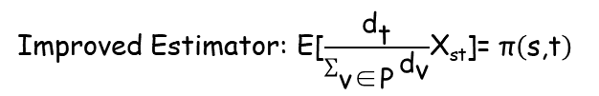
2. Our Solutions
Two spanning forest based estimators!
X_{st}=1 if s is rooted in t in the sampled spanning forest
Basic Estimator: E[X_{st}]= $\text{π}\left(\text{s}\text{,}\text{t}\right)$
Improved Estimator: E[$\frac{{\text{d}}_{\text{t}}}{\sum_{\text{v}\text{∈}\text{P}}{{\text{d}}_{\text{v}}}}$X_{st}]= $\text{π}\left(\text{s}\text{,}\text{t}\right)$
X_{st}=1 if s and t are in the same connected component P in the sampled spanning forest

Slide 13
2. Our Solutions
The relation to RSFs brings novel, effective algorithms!
2
5
1
3
7
Walk from 1
4
6
2
5
1
3
7
4
6
Walk from 4
Drawbacks of traditional algorithms: i) reduplicative steps ii) only care about endpoint
There are many efficient algorithms to sample random spanning trees/forests
Among them, the most effective is the Wilson algorithm

Slide 14
2. Our Solutions
The relation to RSFs brings novel, effective algorithms!
Loop-erased random walk: ignoring loops in random walk, has many significant probability properties
2
Loop-erased walk from 4
5
1
3
7
4
6
2
The loop erasure: trajectory erasing loops
5
1
3
7
4
6
The idea of the Wilson algorithm: Loop erasures on graph forms a random spanning tree/forest

Slide 15
2. Our Solutions
The relation to RSFs brings novel, effective algorithms!
The process of the modified Wilson algorithm
Fixing an ordering of nodes: i.e. 1, 2, …, n Initialize F=$\text{∅}$
Run $\text{α}$-random walk by this order, add the loop-erasure to F
2
5
Walk from 1
1
3
7
4
6
Run $\text{α}$-random walks outside from F, until it stops or hits F
2
5
1
3
Walk from 2, 5, 6
7
4
6
Terminate when F spans all nodes

Slide 16
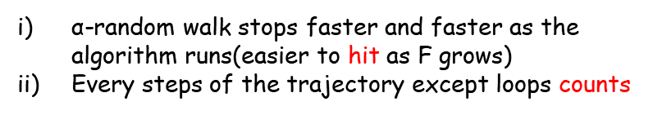
2. Our Solutions
This advantages of the new algorithm:
2
+1
Reduplicative steps
Only care about endpoint
5
1
3
7
4
6
2
+1
$\text{α}$-random walk stops faster and faster as the algorithm runs(easier to hit as F grows)
Every steps of the trajectory except loops counts
5
1
3
7
4
6
+1/4
Even more efficient when consider Rao-Blackwellization
Side information
+1/4
+1/4
+1/4

Slide 17
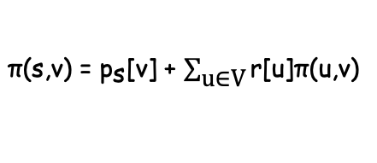

2. Our Solutions
Application 1: Single Source Personalized Pagerank Query
$\text{π}\text{(}\text{s}\text{,}\text{v}\text{)}$ for all v$\text{ϵ}$V, a row of the matrix ${\text{L}}_{\text{β}}^{\text{−1}}$
Sum up to 1
An efficient deterministic local push method: forward push
During the push procedure, the following invariant is maintained:
$\text{π}\text{(}\text{s}\text{,}\text{v}\text{)}$ = ${\text{p}}_{\text{s}}$[v] + $\sum_{\text{u}\text{∈}\text{V}}{\text{r}\text{[}\text{u}\text{]}\text{π}\text{(}\text{u}\text{,}\text{v}\text{)}}$
Current estimation
Error
Idea first introduced by Logfren 15’
Using Monte Carlo methods to estimate the error
For Single Source query, it requires to simulate random walks from all nodes.
This is exactly what we optimize!

Slide 18
2. Our Solutions
Application 1: Single Source Personalized Pagerank Query
The state-of-the-art algorithm mostly adopts the bidirectional framework
FORA(KDD’ 16): The first bidirectional Single Source algorithm
ResAcc(ICDE’ 20): Accumulate residuals in forward push
SpeedPPR(SIGMOD’ 21): Unifying power method and forward push in an engineering point of view
Most current works focus on optimizing the deterministic direction,
Little work make efforts to the randomized direction!
Our work improves the efficiency of the randomized direction, thus gives the best approximate algorithm for Single Source query with approximation guarantees.

Slide 19


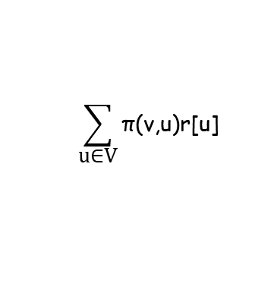
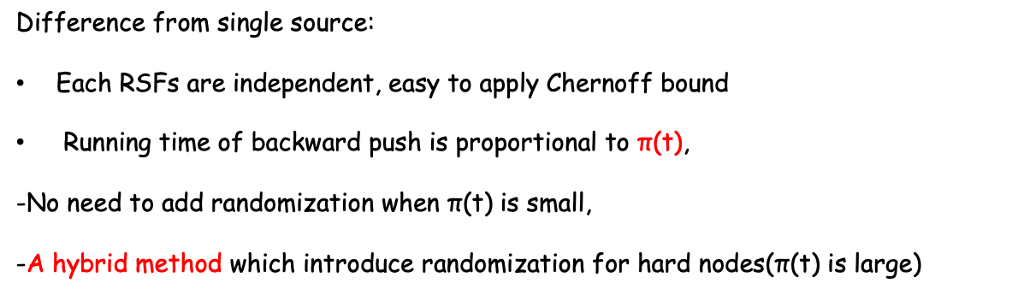
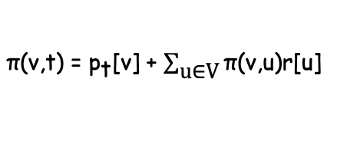
2. Our Solutions
Application 2: Single Target Personalized Pagerank Query
Sum up to $\text{π}\text{(}\text{t}\text{)}$
$\text{π}\text{(}\text{v}\text{,}\text{t}\text{)}$ for all v$\text{ϵ}$V, a column of the matrix ${\text{L}}_{\text{β}}^{\text{−1}}$
An efficient deterministic local push method: backward push
$\text{π}\text{(}\text{v}\text{,}\text{t}\text{)}$ = ${\text{p}}_{\text{t}}$[v] + $\sum_{\text{u}\text{∈}\text{V}}{\text{π}\text{(}\text{v}\text{,}\text{u}\text{)}\text{r}\text{[}\text{u}\text{]}}$
Difference from single source:
Each RSFs are independent, easy to apply Chernoff bound
Running time of backward push is proportional to $\text{π}\text{(}\text{t}\text{)}$,
-No need to add randomization when $\text{π}\text{(}\text{t}\text{)}$ is small,
-A hybrid method which introduce randomization for hard nodes($\text{π}\text{(}\text{t}\text{)}$ is large)
$$\sum_{\text{u}\text{∈}\text{V}}{\text{π}\text{(}\text{v}\text{,}\text{u}\text{)}\text{r}\text{[}\text{u}\text{]}}$$
Which node v is rooted in

Slide 20
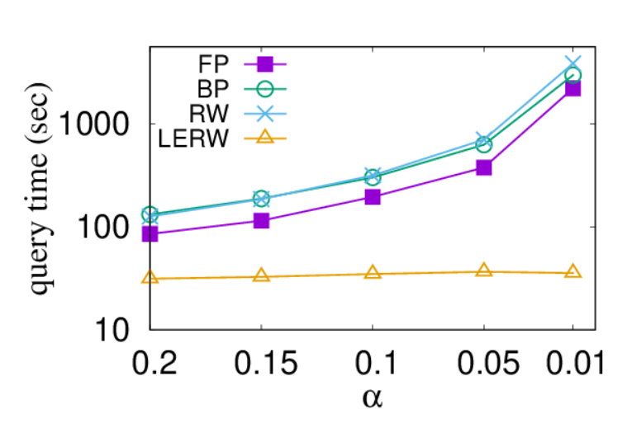


3. Experimental Results
Local push, random walk methods are sensitive to $\text{α}$
When $\text{α}$ is small, random walk becomes harder to stop, walks more steps, exploring larger part of the graph(more global), former algorithms are far from efficient!
$\text{×}\text{200}$ times
Most current algorithms are sensitive to $\text{α}$, becomes harder as $\text{α}\text{→0}$
Our algorithm is significantly better when $\text{α}$ is small

Slide 21
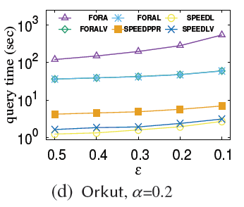
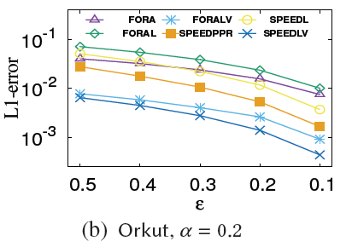
3. Experimental Results
Comparison with competitors:
Single Source Query $\text{α}$=0.2
Speed-up over the state-of-the-art algorithms
Best empirical error via improved estimator

Slide 22
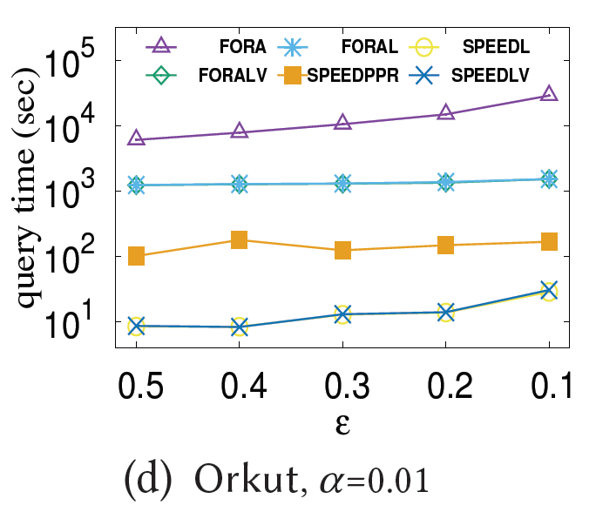
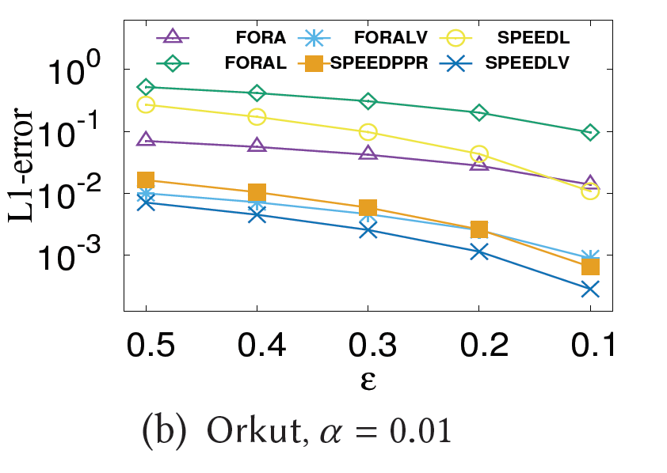
3. Experimental Results
Comparison with competitors:
Single Source Query $\text{α}$=0.01
Speed-up over the state-of-the-art algorithms
Best empirical error via improved estimator

Slide 23
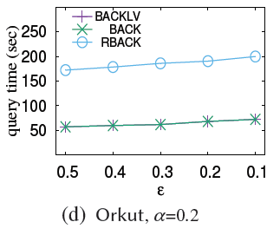
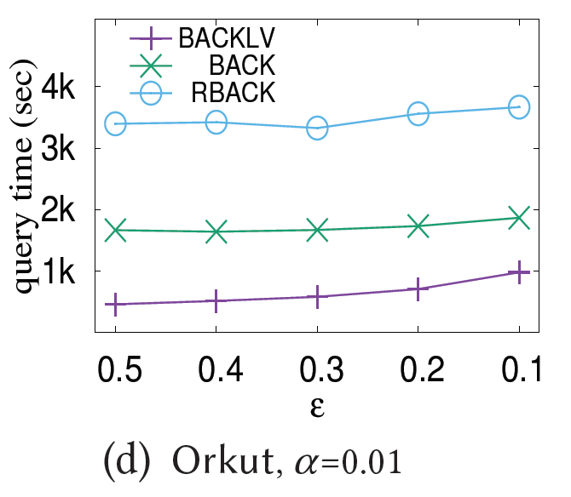


3. Experimental Results
Comparison with competitors:
Single Target Query $\text{α}$=0.2
Single Target Query $\text{α}$=0.01
For top 10% degree nodes:
Degrade to push when $\text{α}$=0.2, obtain a speed-up when $\text{α}$=0.01

Slide 24

Take Home Message
Personalized PageRank can be explained through the weight of rooted spanning forests!
Relations to RSFs brings efficient loop-erased $\text{α}$-random walk sampling algorithms!

Slide 25
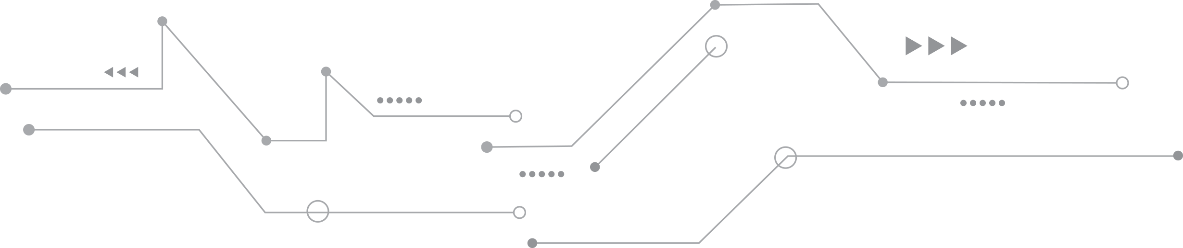
THANKS

